Slide 1
IoT solutions on Azure
“ ”
autumn 2019 Joanna Lamch
Notes:
dziekuje ze tak licznie przybyliscie na moja prezentacje i mozliwosc podzielenia się z wami odrobina wiedzy jaka zebrałam …. Nie wiem co dodac
Chciałabym wam przybliżyć choć trochę temat web assembly –

Slide 2
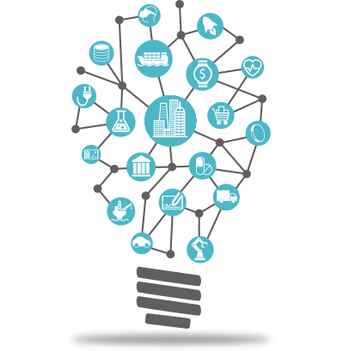
Internet of Things
The network of physical objects that contain embedded technology to communicate and interact with their internal states or the external environment.

Slide 3
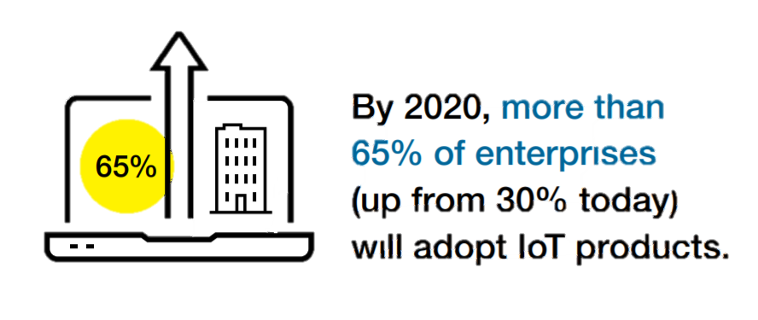
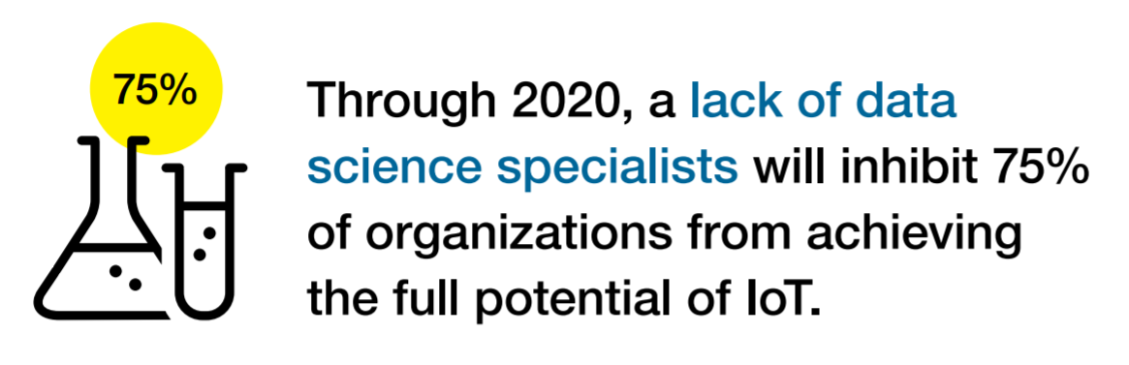
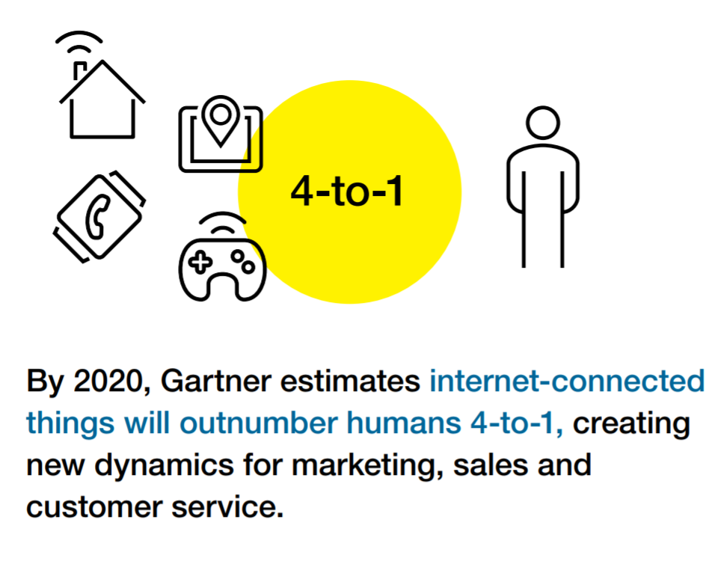
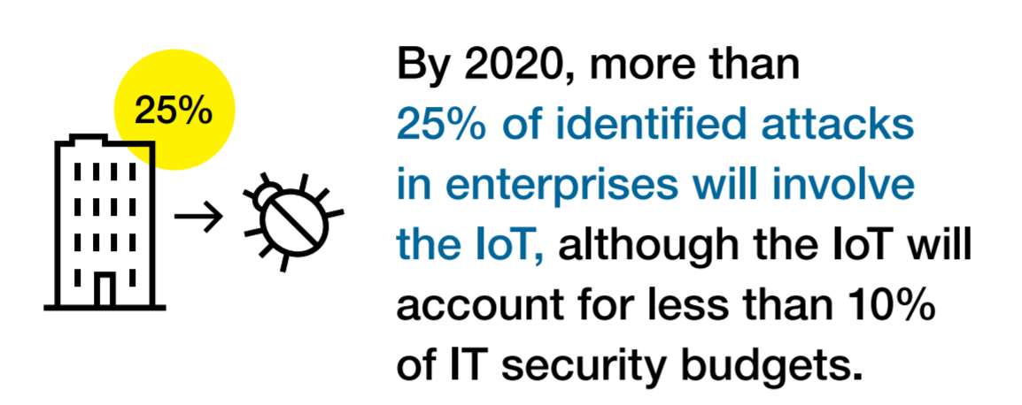
IoT by Gartner 2020
26
billions
Notes:
26 billion connected devices by 2020
Worldwide market for IoT solutions to reach $7.2 trillion in 2020 (IDC)
Economic value-add is forecast to be $2 trillion across sectors in 2020 177$ millions in productivity increase (Gartner)
Microsoft will invest $5B in IoT and intelligent edge till 2022
Leading Industry examples :
utilities, insurance, agriculture,
factory, automobiles, transport, consumer, etc

Slide 4
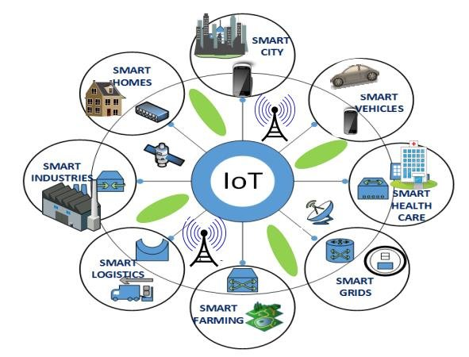
IoT business scenarios
Manufacturing
Smart City
Smart Building
Healthcare
Energy
Transportation and Smart Vehicles
Logistics and Inventory Management
Retail
Agriculture

Slide 5
IoT Business Maturity Model
1. Operational efficiency
Connect devices and monitor telemetry
Monitor and track device state, location and health
Things
Rules and alerting to improve operational efficiency
Notes:
Most customers adopting the IoT tend to follow a similar pattern.
- It starts with organizations hunting for operational efficiency.
- Subsequently they begin by connecting devices and capturing data. The cloud means that traditional concerns about ‘too much data’ are much less prevalent.
- Customers will be monitoring the IoT devices themselves and the things they they’re connected to.
Often customers will be using real time rules and alerting to make decisions in an ad hoc fashion about their things.

Slide 6
IoT Business Maturity Model
2. Business Intelligence
Analyze and visualize data from devices
Discover patterns in device data using predictive analytics
Things
Operationalize insights to improve things and processes in real time
Notes:
Next, organizations start to develop some business intelligence around the huge streams of data.
Once they’ve built a data set customers will start to derive insight from this. This moves from experimentation and exploration of data to insight, often using machine learning and other statistical and predictive models.
The cloud and predictive analytics work really well together. This is because predictive analytics requires a lot of computing power, which is ‘on tap’ in the cloud.
Insight allows customers to take better decisions as they run their business. Some of these will be real time operationalization of predictive models, some of these will be longer term strategic decisions.

Slide 7
IoT Business Maturity Model
3. Business Transformation
Combine IoT & other data with advanced analytics to power new services and revenue streams
Expand into new adjacent businesses
Things
New partnership opportunities
Notes:
Customers then integrate IoT into their broader business and explore new areas in which to deploy IoT solutions.
Data and devices in the field unlock new opportunities to partner with other organisations who’re also interested in the hardware platforms and data streams.
The cycle continues.

Slide 8
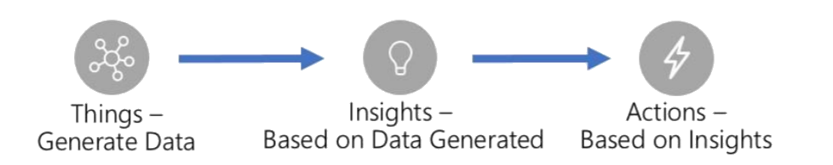
A simple view of an IoT solution
Things
Insights
Actions

Slide 9
A more realistic view…
Deployment
Fault tolerance
Solution scale
Data storage
Business process integration
Enterprise integration
Cold path analytics
Provisioning devices
Cost management
Operations monitoring
Device recovery
Internationalization
High availability
Updating devices
Cloud-to-device
commands
Device lifecycle
Transport protocols
Warm path analytics
Drivers
Things
Disaster recovery
Insights
Actions
Hot path analytics
Device updates
Data ownership
< ---- END-TO-END SECURITY ---- >
On device analytics
Data visualization
Manufacturing scale
Industry and government compliance
HW certification
Securing data
… and why IoT needs simplifying
Device commercialization

Slide 10
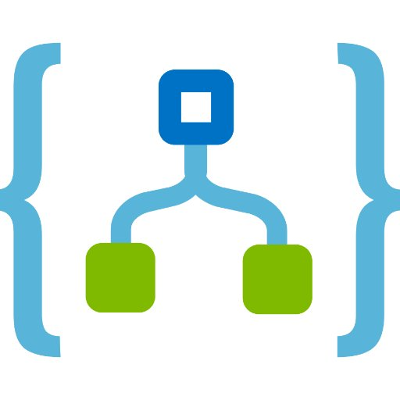




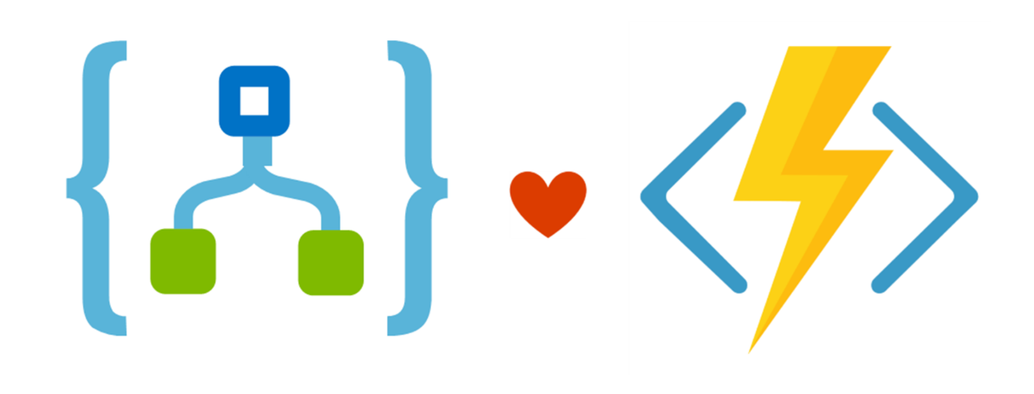








A more realistic view…
Fault tolerance
Solution scale
Data storage
Business process integration
Enterprise integration
Cold path analytics
Provisioning devices
Cost management
Operations monitoring
Device recovery
Internationalization
High availability
Deployment
Cloud-to-device
commands
Updating devices
Transport protocols
Device lifecycle
Warm path analytics
Drivers
Things
Disaster recovery
Insights
Actions
Hot path analytics
Device updates
Data ownership
< ---- END-TO-END SECURITY ---- >
On device analytics
Data visualization
Manufacturing scale
Industry and government compliance
HW certification
Securing data
… and why IoT needs simplifying
Device commercialization

Slide 11
IoT architecture requirements
Handle extreme hardware and software heterogeneity
Build for hyper-scale and enable low data latency
Think about security, be secure by design; support defense in depth
Lower barriers to entry: evaluate -> prototype -> deploy -> update
Think big, but start small (experiment, learn and refine)
Deliver telemetry and notifications that are meaningful even at extreme scale
Provide hot-path and cold-path analysis and action/response.

Slide 12
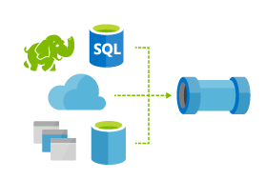
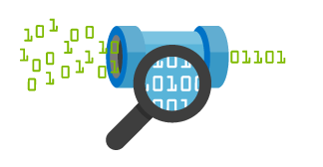
Things
Insights
Actions
Azure IoT Architecture
Cold Path Analytics
Find insights over historical data
Technology
Azure ML, and Azure Data Lake Analytics
Things
Insights
Actions
Technology
Azure IoT Device SDK
Azure IoT Edge
IoT Hub Cloud Gateway
Connect and Manage Devices
Hot Path Analytics
Real-time monitoring
Technology
Azure Stream Analytics, and HDInsight Spark & Storm
Manage
View and manage solutions
Technology
App Service, Power Bi, API Apps, Mobile Apps, Xamarin Apps, and Azure Search
Protocol Adaptation
Warm Path Analytics
Ad-hoc visual exploration of time series data
Technology
Azure Time Series Insights
Field Gateway
Protocol Adaptation
Business Integration
Connect to business process
Technology
Azure Logic Apps, API Management, Biztalk Services
Field Gateway

Slide 13
Lambda Architecture
slow path
Things
Insights
Actions
IoT Hub Cloud Gateway
Store
Display
Analyze
Action
fast path
Analyze
Action
Route
Store
Display

Slide 14
Azure IoT Hub
Device handling special force unit

Slide 15
Azure IoT Hub
Bi-directional communication

Slide 16

IoT Communication - Information Exchange Patterns
Information flowing from a device to other systems for conveying status of device and environment
Telemetry
Requests from devices looking to gather required information or to initiate activities
Inquiries
Commands from other systems to a device or a group of devices to perform specific activities
Commands
Information flowing from other systems to a device (group) for conveying status changes
Notifications

Slide 17
Azure IoT Hub
Bi-directional communication
  Millions of Devices
  Multi-language, open source SDKs
  HTTPS/AMQPS/MQTTS
  Multi-language, open source SDKs
  HTTPS vs AMQPS vs MQTTS

Slide 18
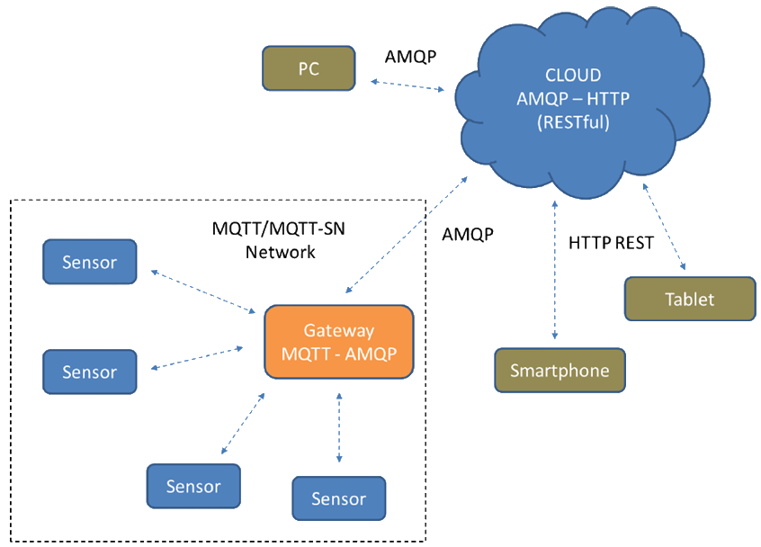
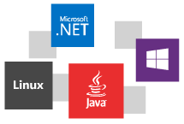
Azure IoT Hub
  Multi-language, open source SDKs
  HTTPS vs AMQPS vs MQTTS

Slide 19
Azure IoT Hub
Bi-directional communication
  Millions of Devices
  Multi-language, open source SDKs
  HTTPS/AMQPS/MQTTS
  Send Telemetry
  Receive Commands
  Device Management
  Device Twins
  Queries & Jobs
  Multi-language, open source SDKs
  HTTPS vs AMQPS vs MQTTS
  Device Management
  Device Twin

Slide 20


  Device Twin
Azure IoT Hub Device Twin
Device Management
  Device Management
  Software
  Firmware
  Configuration
IoT Hub
IoT Device
Telemetry
Telemetry channel
Device Twin
Device Twin
Properties
Properties
Cloud owned, device visible
Desired
Desired
Reported
Reported
Device owned, cloud visible
Tags
Cloud only,
device metadata
Methods
Methods
Cloud initiated C2D with response
Commands
Cloud initiated C2D message
Notes:
Easier to manage devices at scale

Slide 21

Device Twin vs Digital Twin
Twin is a cloud base representation of something that is remote
Device Twin is
  A key/value flat representation of
    Desired configuration
    Reported configuration
    Keys to match to an external database
Digital Twin is
  A graph
  Richer semantics
  Not only devices – focused on resources

Slide 22
Azure IoT Hub
Bi-directional communication
Enterprise scale & integration
  Millions of Devices
  Multi-language, open source SDKs
  HTTPS/AMQPS/MQTTS
  Send Telemetry
  Receive Commands
  Device Management
  Device Twins
  Queries & Jobs
  Billions of messages
  Scale up and down
  Declarative Message Routes
  File Upload
  WebSockets & Multiplexing
  Azure Monitor
  Azure Resource Health
  Configuration Management

Slide 23
Azure IoT Hub
Bi-directional communication
Enterprise scale & integration
End-to-End Security
  Millions of Devices
  Multi-language, open source SDKs
  HTTPS/AMQPS/MQTTS
  Send Telemetry
  Receive Commands
  Device Management
  Device Twins
  Queries & Jobs
  Billions of messages
  Scale up and down
  Declarative Message Routes
  File Upload
  WebSockets & Multiplexing
  Azure Monitor
  Azure Resource Health
  Configuration Management
  Per Device Certificates
  Per Device Enable/Disable
  TLS Security
  X.509 Support
  IP Whitelisting/Blacklisting
  Shared Access Polices
  Firmware/Software Updates

Slide 24
IoT protection stack
Device
protection
Threat
resistance
Data protection in-motion
Cloud
security
Response
Trusted Platform Module (TPM)
Device Guard
X.509 or
TLS-Based Handshake and Encryption
Encryption at Rest
Azure Active Directory
Key Vault
Policy-Based Access Control
IP- based blocking
Secure Device Registration
Standards-based best practices
Device Management
Device Recovery
Device-specific
repudiation

Slide 25
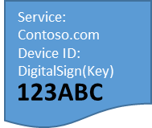


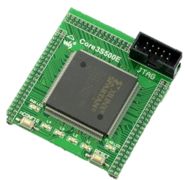


Provision devices at scale: DPS
IoT Hub Device Provisioning Service
Enables IoT devices to receive provisioning
information automatically
without manual interaction
when the device
first connects
to a network.
Azure IoT Hub Device Provisioning service
Azure IoT Hub
Service: Contoso.com
HW ID:
Device ID:
DigitalSign(Key)
3
123ABC
HW with ID “123ABC”
was produced
URL, Device Name, SymKey
4
I am “DigitalSign(Key)”:
[Data] & [DM]
I am device “123ABC”
1
2
123ABC
123ABC
Manufacturer
Shipping
Customer

Slide 26
Microsoft is simplifying IoT
Azure IoT Solution Accelerators
Solution accelerators
for common IoT scenarios
Azure IoT Central
Fully managed IoT SaaS
No cloud solution expertise required
Remote Monitoring | Predictive Maintenance | Connected Factory
SaaS
  Azure IoT Hub
  Azure Stream Analytics
  Azure Time Series Insights
  Azure Machine Learning
  Azure Logic Apps
  More
PaaS

Slide 27
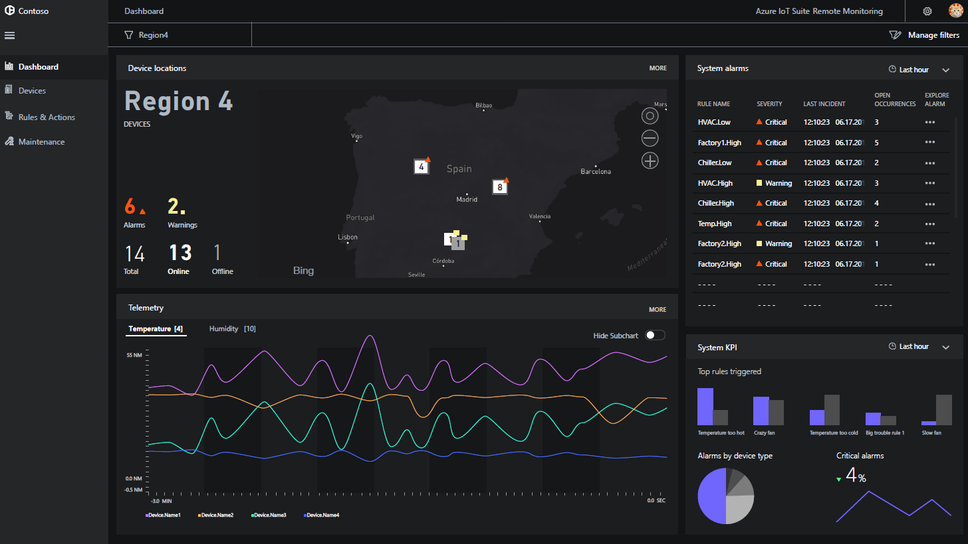
Azure IoT solution accelerators
Device Connectivity & Management
Data Ingestion and Command & Control
Stream Processing & Predictive Analytics
Workflow Automation and Integration
Dashboards, Visualization & Insights
Preconfigured Solutions
Remote monitoring
Predictive maintenance
Connected factory

Slide 28
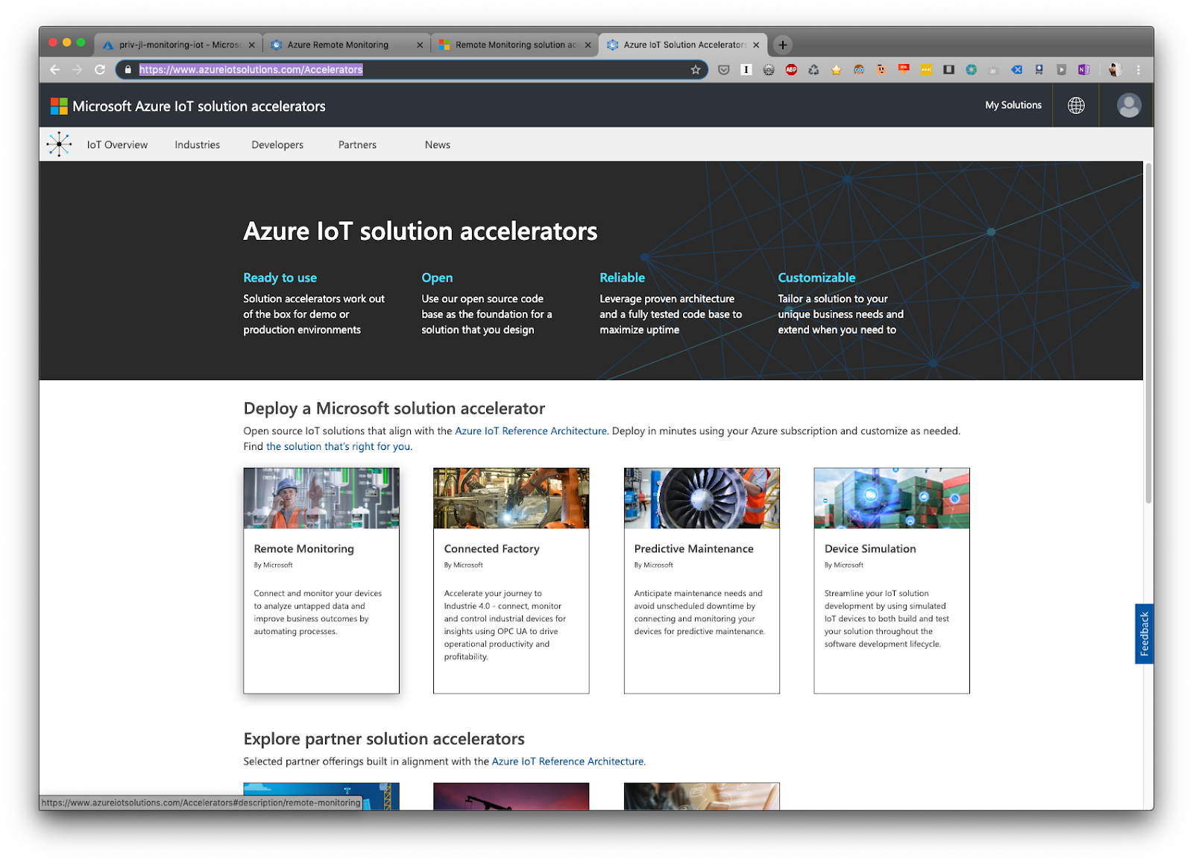
Azure IoT solution accelerators

Slide 30
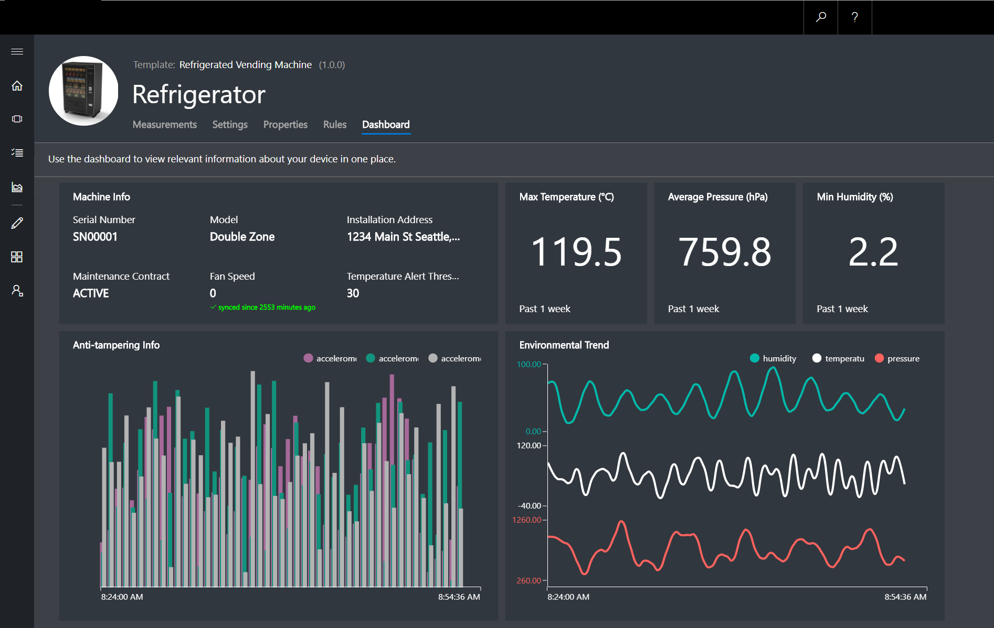
Azure IoT Central
Device Connectivity & Management
Telemetry Ingestion and Command & Control
Monitoring Rules & Triggered Actions
User roles and permissions
Dashboards, Visualization & Insights
Fully Hosted & Managed by Microsoft

Slide 31

Iot central Demo

Slide 32

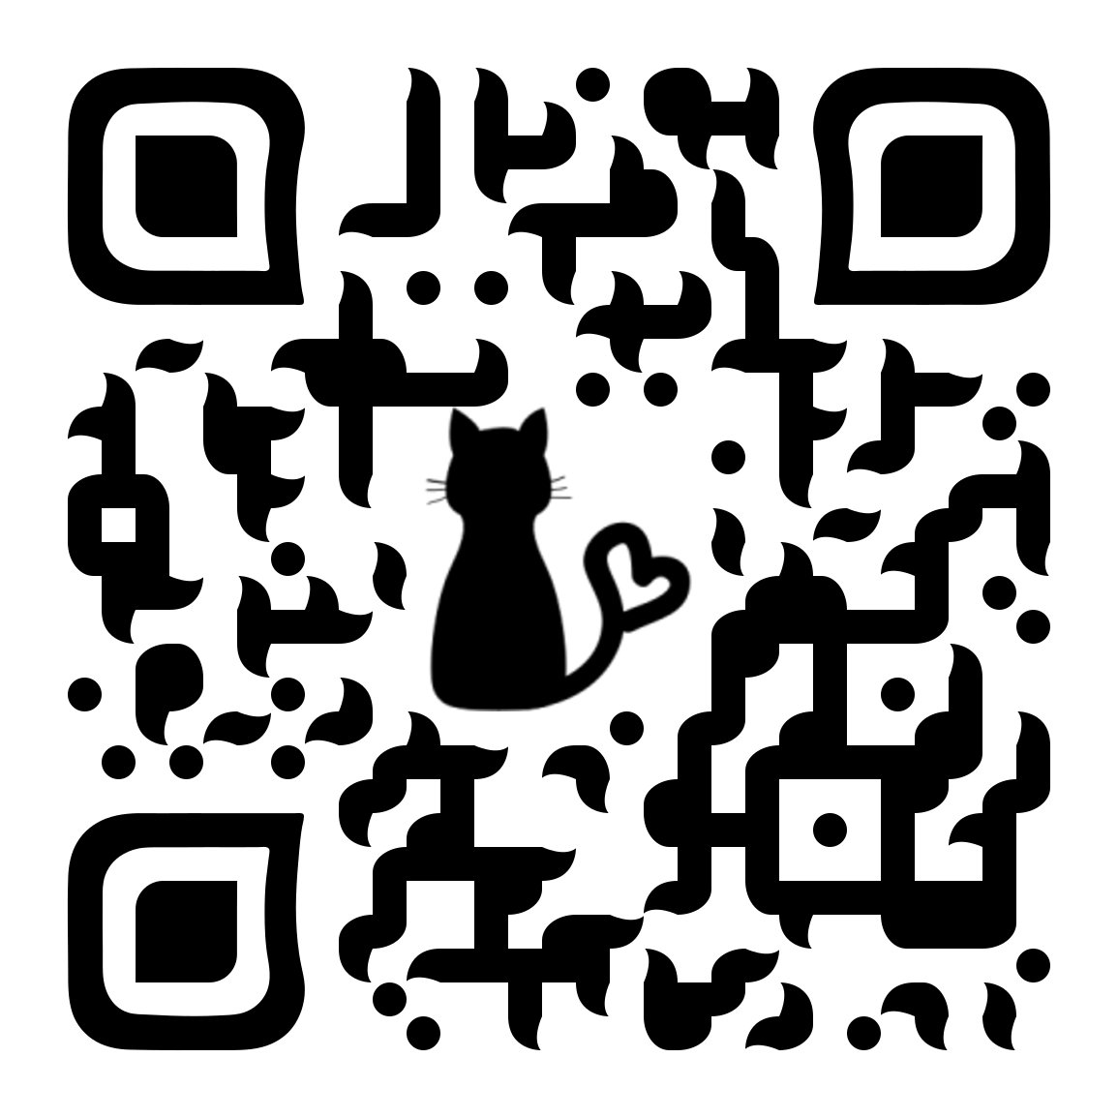



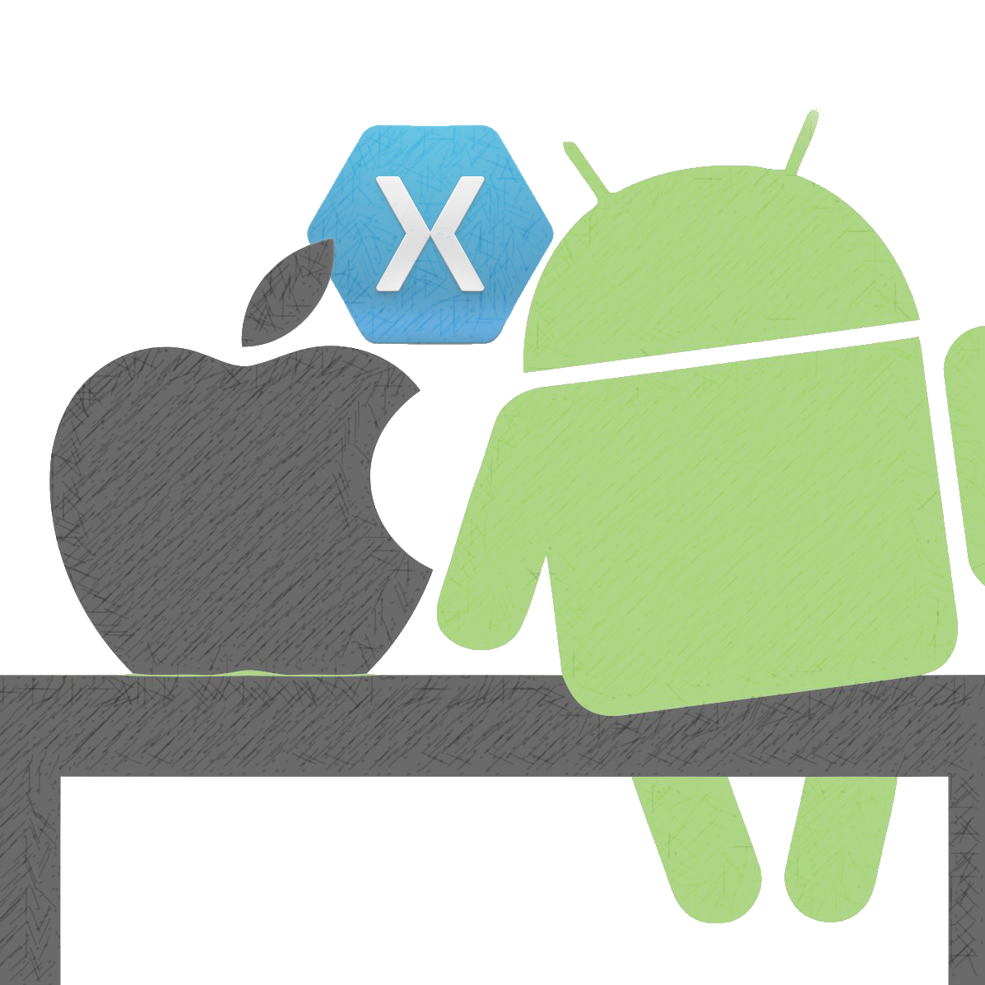


Questions??
Joanna Lamch
JLamch@gmail.com
https://JLamch.net
https://ProgramistkaIKot.pl
THANK YOU

