Slide 1
WebAssembly the end of JavaScript?
Joanna Lamch
2019
Notes:
dziekuje ze tak licznie przybyliscie na moja prezentacje i mozliwosc podzielenia się z wami odrobina wiedzy jaka zebrałam …. Nie wiem co dodac
Chciałabym wam przybliżyć choć trochę temat web assembly –

Slide 2
Back in the days…
Notes:
Ale zacznijmy od malego skosu w histori

Slide 3
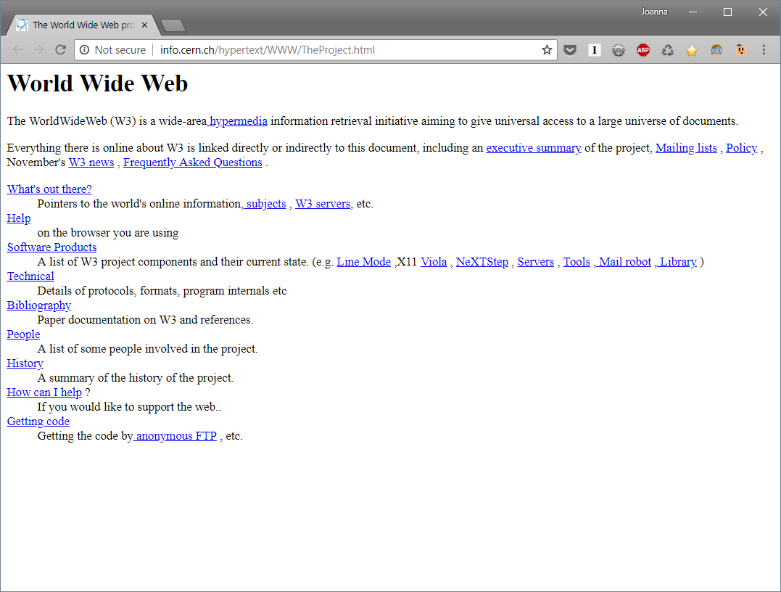
1991
https://www.businessinsider.com/flashback-this-is-what-the-first-website-ever-looked-like-2011-6?IR=T
https://www.businessinsider.com/what-is-the-internet-and-how-the-internet-works2011-6?IR=T#first-you-should-know-how-the-internet-came-to-be-its-existence-can-be-traced-back-to-the-ussrs-sputnik-in-the-1950s-1
Notes:
August 6, 1991
Tim Berners-Lee
CERN (on NeXT computer)
Hypertext linki I zawartosc

Slide 4
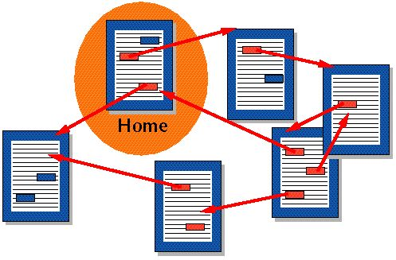
Hypertext, HTML, HTTP
Hypertext documents are interconnected by hyperlinks, which are activated by a mouseClick, keypress set or by touching the screen
„Hypertext" is also used to describe tables, images, and other content formats with integrated hyperlinks. Hypertext is one of the key underlying concepts of the World Wide Web, where Web pages are often written in the Hypertext Markup Language (HTML). As implemented on the Web, hypertext enables the easy-to-use publication of information over the Internet.
The Hypertext Transfer Protocol (HTTP) is an application protocol for distributed, collaborative, and hypermedia information systems. HTTP is the protocol to exchange or transfer hypertext.
Notes:
Tylko zawartosc I linki
statycznie

Slide 5
JavaScript
created in 10 days in May 1995, by Brendan Eich for Netscape
Adding interactivity to HTML pages
1995
Notes:
10 days prototype as Java like language JavaScript enables interactive web pages and thus is an essential part of web applications.
Dowcipkowal ze zrobil to na kacu

Slide 6
JavaScript
1995
Notes:
JS jezyk zrozumialy dla ludzi – latwy do zrozumienia
Dynamiczne typy
Ale czytelna dla developera – trade off
ByteCode is run in interpretor

Slide 7
JavaScript
Parse
Run / Execute
Garbage collection
1995
Notes:
Nie zaprojektowana aby była szybka
Jest wolniej ale jest latwo uzywac wiec wszyscy się na to godza.
Poprostu parsowanie I wykonanie. powolne

Slide 8
Other plugins
Java Applets [1997]
ActiveX [1996]
Flash [1996]
Silverlight [2007]
1996+
Notes:
2007
W miedzyczasie potrzeba innych jezykow,
Potrzeba potezniejszych narzedzi, wiekszych mozliwosci
Ale ogromne dziury w zabezpieczeniach I podatnosc na ataki

Slide 9
Other plugins
Java Applets [1997]
ActiveX [1996]
Flash [1996]
Silverlight [2007]
All of them are deprecated
or will be deprecated soon
1996+
Notes:
2007
W miedzyczasie potrzeba innych jezykow,
Potrzeba potezniejszych narzedzi, wiekszych mozliwosci
Ale ogromne dziury w zabezpieczeniach I podatnosc na ataki

Slide 10
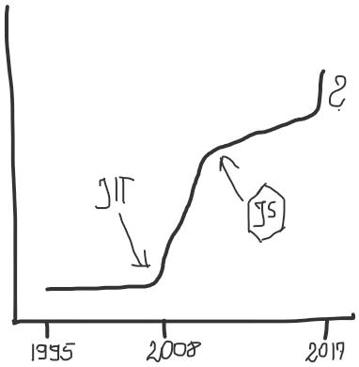
Browser performance wars (2008+)
Notes:
2008 wojny przegladarek.
Kompilatory just in time

Slide 11
Browser performance wars (2008+)
Notes:
2009 node.js and server side JS
Coraz lepsze silniki.
V8 Chrom,
SpiderMonkey – Firefox
Chakra – Edge
Nitro, SquirrelFish, JavaScriptCore -Safari

Slide 12
Browser performance wars (2008+)
ASM.js
https://blog.mozilla.org/luke/2014/01/14/asm-js-aot-compilation-and-startup-performance/
OdinMonkey
Notes:
Optymalizacja w trakcie uruchomienia
OdynMonkey uzywal kompilacji AOT in runtime kbum

Slide 13
Browser performance wars (2008+)
Parse
Compile and organize
Run / Execute
Re-organize
Garbage collection
Notes:
Ten wykres moze sie roznic z program na program.
Ale jest ten etap reorganizacji kodu I compilacji na zasadzie przygotowania do uzycia

Slide 14
Todays JavaScript
Different way the same language
there is a LOT of JavaScript
JavaScript is
the language of the Web
But it’s not very good
Assembly Language (still human readable simple language)
Notes:
Obecnie JS jest wszedzie.
Jest go strasznie duzo
Niski prog wejscia, obietnica zycia w swiecie IT
Ogromne zapotrzebowanie
Ogromne mozliwosci
Najbardziej uniwersalna platforma – WEB
JS jest jezykiem internetu
Ale nie jest jezykiem Assembly – jest human readable language

Slide 15
Todays JavaScript
Notes:
Obecnie JS jest wszedzie.
Jest go strasznie duzo
Niski prog wejscia, obietnica zycia w swiecie IT
Ogromne zapotrzebowanie
Ogromne mozliwosci
Najbardziej uniwersalna platforma – WEB
JS jest jezykiem internetu
Ale nie jest jezykiem Assembly – jest human readable language

Slide 16
WebAssembly What? Why?
A new low-level binary format for the web (WASM)
It’s a bytecode for web / compilation target => maximized performance
Notes:
Compile target for web (bytecode)
Uses linear memory
WebAssembly (abbreviated Wasm) is a binary instruction format for a stack-based virtual machine. Wasm is designed as a portable target for compilation of high-level languages like C/C++/Rust, enabling deployment on the web for client and server applications.

Slide 17
Wait… What?
Let’s revisit how we humans, communicate with machines

Slide 18
000100111011
1101001010 01
Wait… What?
Let’s revisit how we humans, communicate with machines
01110001010101

Slide 19
push rbx
mov 90, ecx
xor rax, rax
add rax, rbx
pop rbx
000100111011
1101001010 01
mov add
01110001010101
Assembler

Slide 20
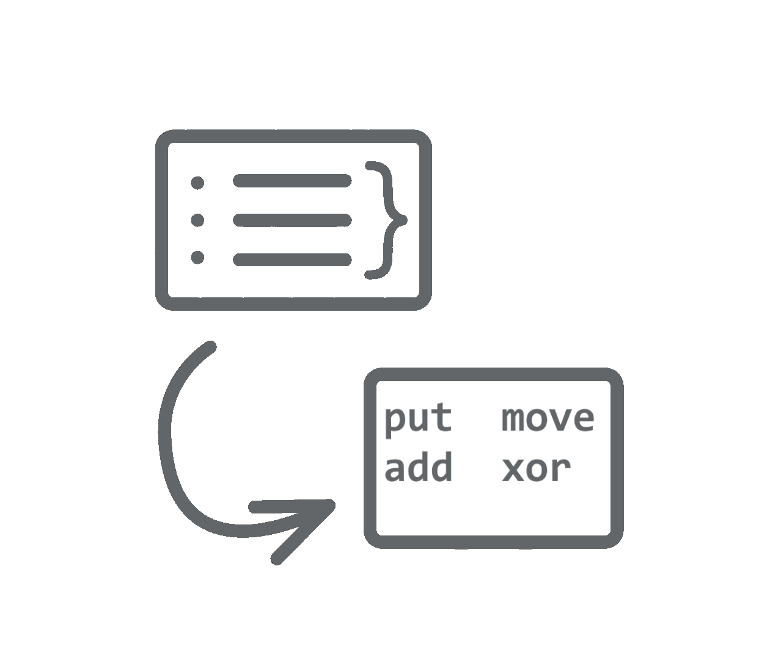
push rbx
mov 90, ecx
xor rax, rax
add rax, rbx
pop rbx
000100111011
1101001010 01
mov add
01110001010101
Compilation magic 🌟

Slide 21
C# C++
Java Kotlin
Rust Swift
push rbx
mov 90, ecx
xor rax, rax
add rax, rbx
pop rbx
000100111011
1101001010 01
mov add
01110001010101
Assembler
Compilation magic 🌟

Slide 22
0110001010101011
01110001010101

Slide 23
0110001010101011
01110001010101

Slide 24
WebAssembly What? Why?
A new low-level binary format for the web (WASM)
It’s a bytecode for web / compilation target => maximized performance
Notes:
Compile target for web (bytecode)
Uses linear memory
WebAssembly (abbreviated Wasm) is a binary instruction format for a stack-based virtual machine. Wasm is designed as a portable target for compilation of high-level languages like C/C++/Rust, enabling deployment on the web for client and server applications.

Slide 25
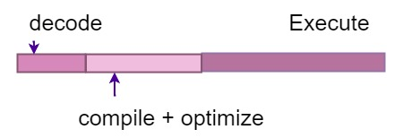
WebAssembly What? Why?
A new low-level binary format for the web (WASM)
It’s a bytecode for web / compilation target => maximized performance
Decode
Execute
Compile + optimize
Notes:
Compile target for web (bytecode)
Uses linear memory
WebAssembly (abbreviated Wasm) is a binary instruction format for a stack-based virtual machine. Wasm is designed as a portable target for compilation of high-level languages like C/C++/Rust, enabling deployment on the web for client and server applications.

Slide 26
WebAssembly What? Why?
A new low-level binary format for the web (WASM)
It’s a bytecode for web / compilation target => maximized performance
Decode
Execute
Compile + optimize
WebAssembly is not designed to replace JS, but to coexist
Sandboxed runtime in JS virtual machine Security it runs locally in JS VM
Notes:
Compile target for web (bytecode)
Uses linear memory
WebAssembly (abbreviated Wasm) is a binary instruction format for a stack-based virtual machine. Wasm is designed as a portable target for compilation of high-level languages like C/C++/Rust, enabling deployment on the web for client and server applications.

Slide 27
WebAssembly What? Why?
A new low-level binary format for the web (WASM)
It’s a bytecode for web / compilation target => maximized performance
Decode
Execute
Compile + optimize
WebAssembly is not designed to replace JS, but to coexist
Sandboxed runtime in JS virtual machine Security it runs locally in JS VM
Supported in all big browsers – W3C open specification
Notes:
Compile target for web (bytecode)
Uses linear memory
WebAssembly (abbreviated Wasm) is a binary instruction format for a stack-based virtual machine. Wasm is designed as a portable target for compilation of high-level languages like C/C++/Rust, enabling deployment on the web for client and server applications.

Slide 28
WebAssembly What? Why?
A new low-level binary format for the web (WASM)
It’s a bytecode for web / compilation target maximized performance
Decode
Execute
Compile + optimize
WebAssembly is not designed to replace JS, but to coexist
Sandboxed runtime in JS virtual machine Security it runs locally in JS VM
Supported in all big browsers – W3C open specification
Compiled from other languages
Notes:
Compile target for web (bytecode)
Uses linear memory
WebAssembly (abbreviated Wasm) is a binary instruction format for a stack-based virtual machine. Wasm is designed as a portable target for compilation of high-level languages like C/C++/Rust, enabling deployment on the web for client and server applications.

Slide 29
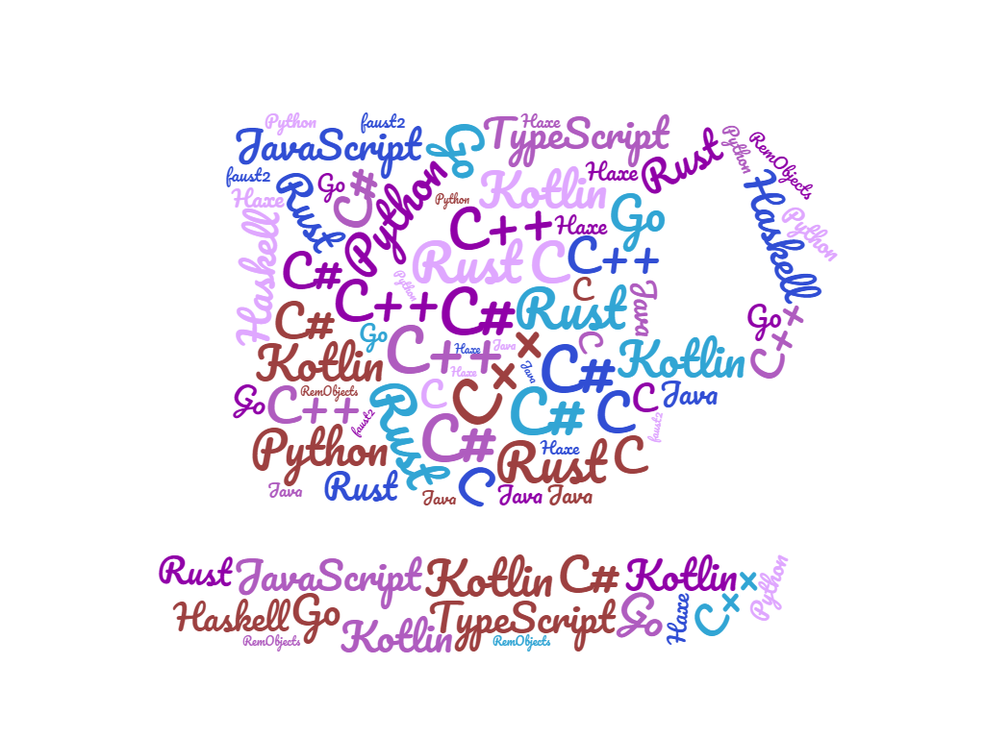
WASM opens possibilities for other languages
Notes:
Rust
C
C++
GO
Kotlin
Python
Haskell
TypeScript
Java
Haxe

Slide 30
WASM opens possibilities for other languages
Notes:
Rust
C
C++
GO
Kotlin
Python
Haskell
TypeScript
Java
Haxe

Slide 31
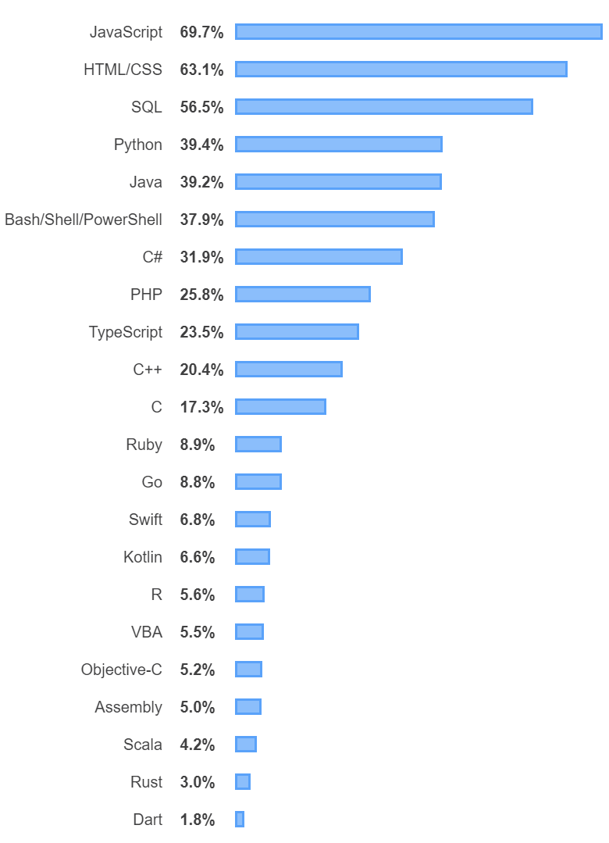
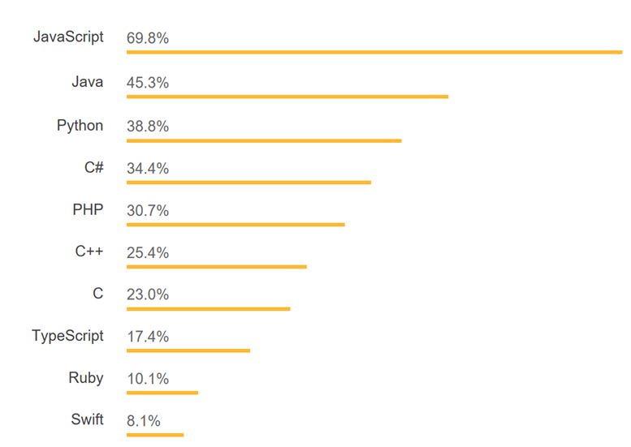
WASM opens possibilities for other languages
Notes:
Rust
C
C++
GO
Kotlin
Python
Haskell
TypeScript
Java
Haxe

Slide 32
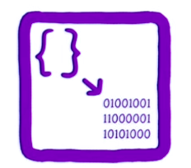
WebAssembly current state: MVP
Compilation target Binary so compact
4 types, 67 instructions, stack machine
Linear memory
Fast execution

Slide 33
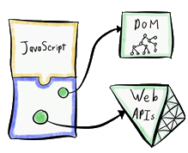
WebAssembly current state: MVP
Compilation target Binary so compact
4 types, 67 instructions, stack machine
Linear memory
Fast execution
or not so fast? jet consistent
not so fast load
No Web APIs, DOM access/manipulation
no Threads

Slide 34
WebAssembly How?
executes the Emscripten compiler
name our output file
$emcc –s WASM=1 -o example.js example.cpp
Emscripten outputs WebAssembly - switch
input file

Slide 35
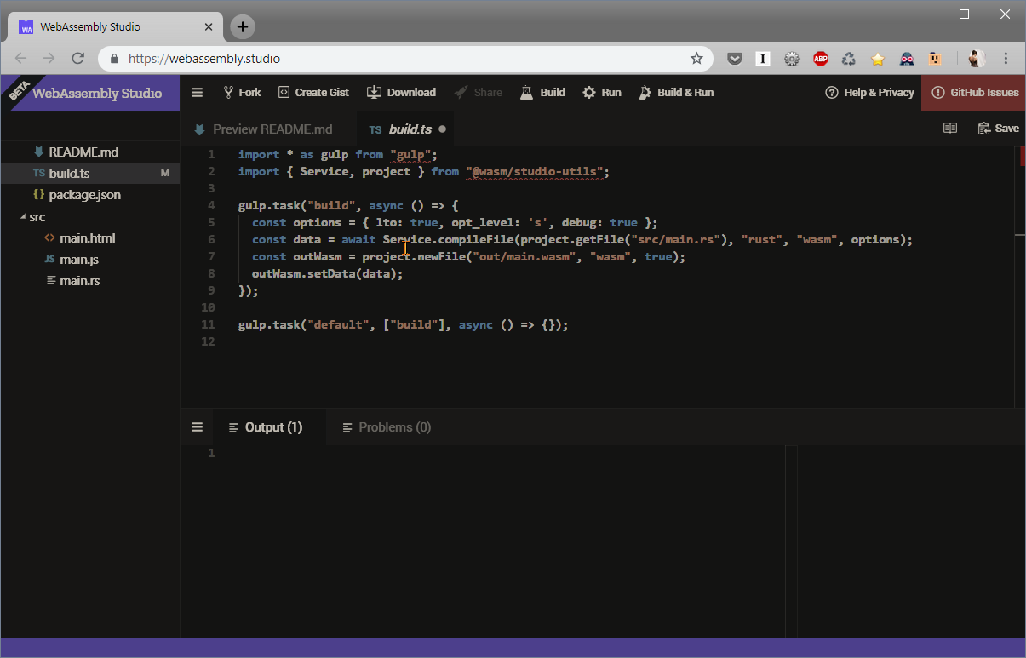
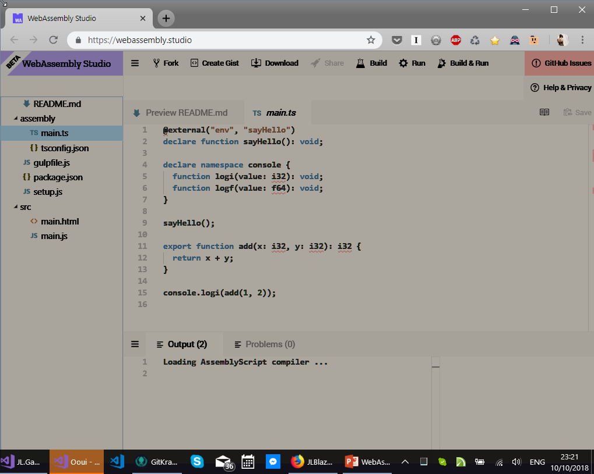
WebAssembly studio C/Rust/TypeScript
https://hacks.mozilla.org/2018/04/sneak-peek-at-webassembly-studio/

Slide 36
Demo
http://mbebenita.github.io/WasmExplorer/
https://wasdk.github.io/WasmFiddle/
https://webassembly.studio/
Notes:
C++ albo rust fibonaczi?
https://github.com/AssemblyScript/assemblyscript

Slide 37
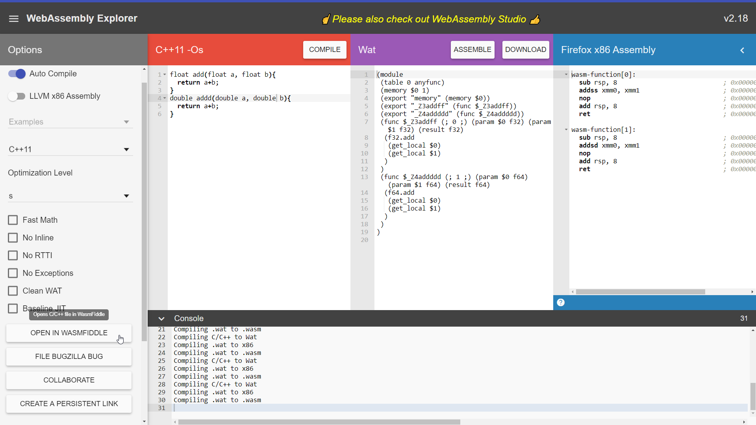

Slide 38
WasmExplorer
https://bit.ly/2nbDUQF

Slide 39
WasmExplorer

Slide 40
WasmExplorer

Slide 41
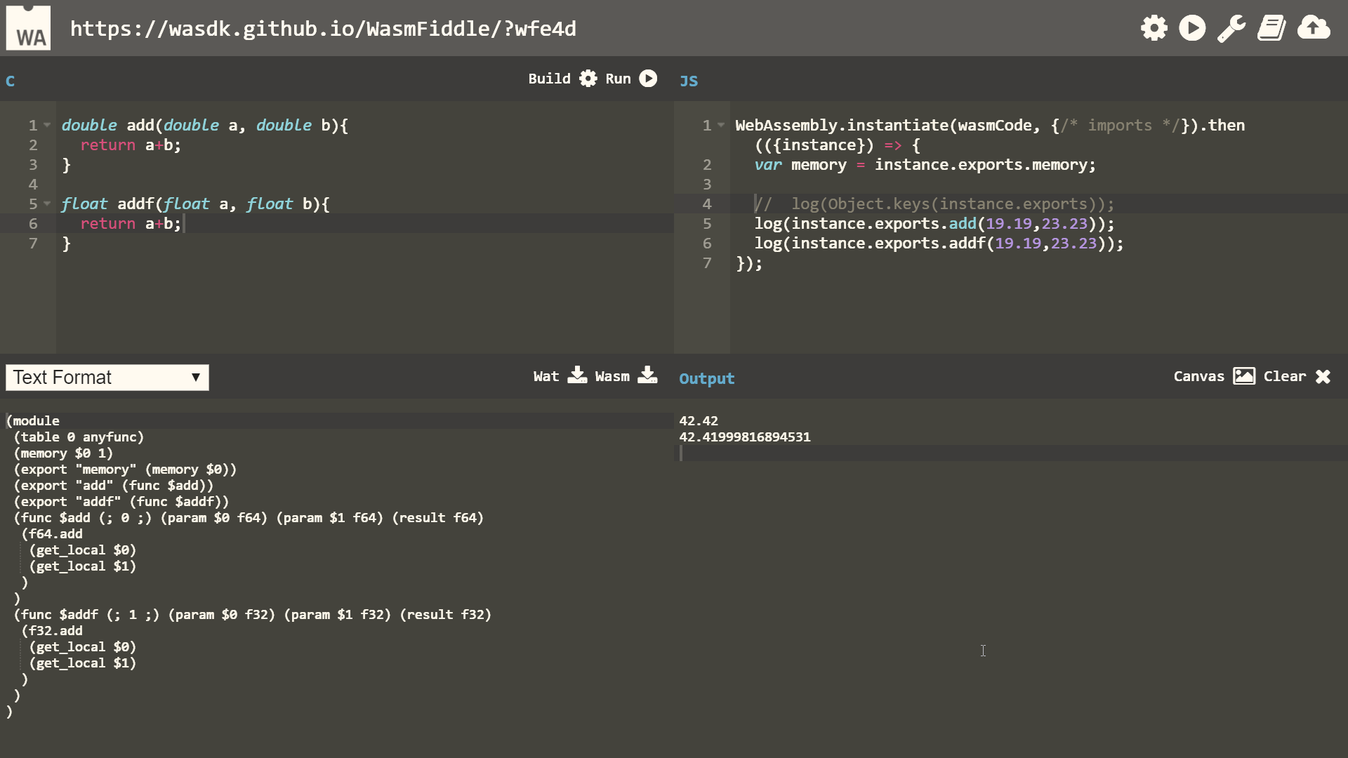

Slide 42
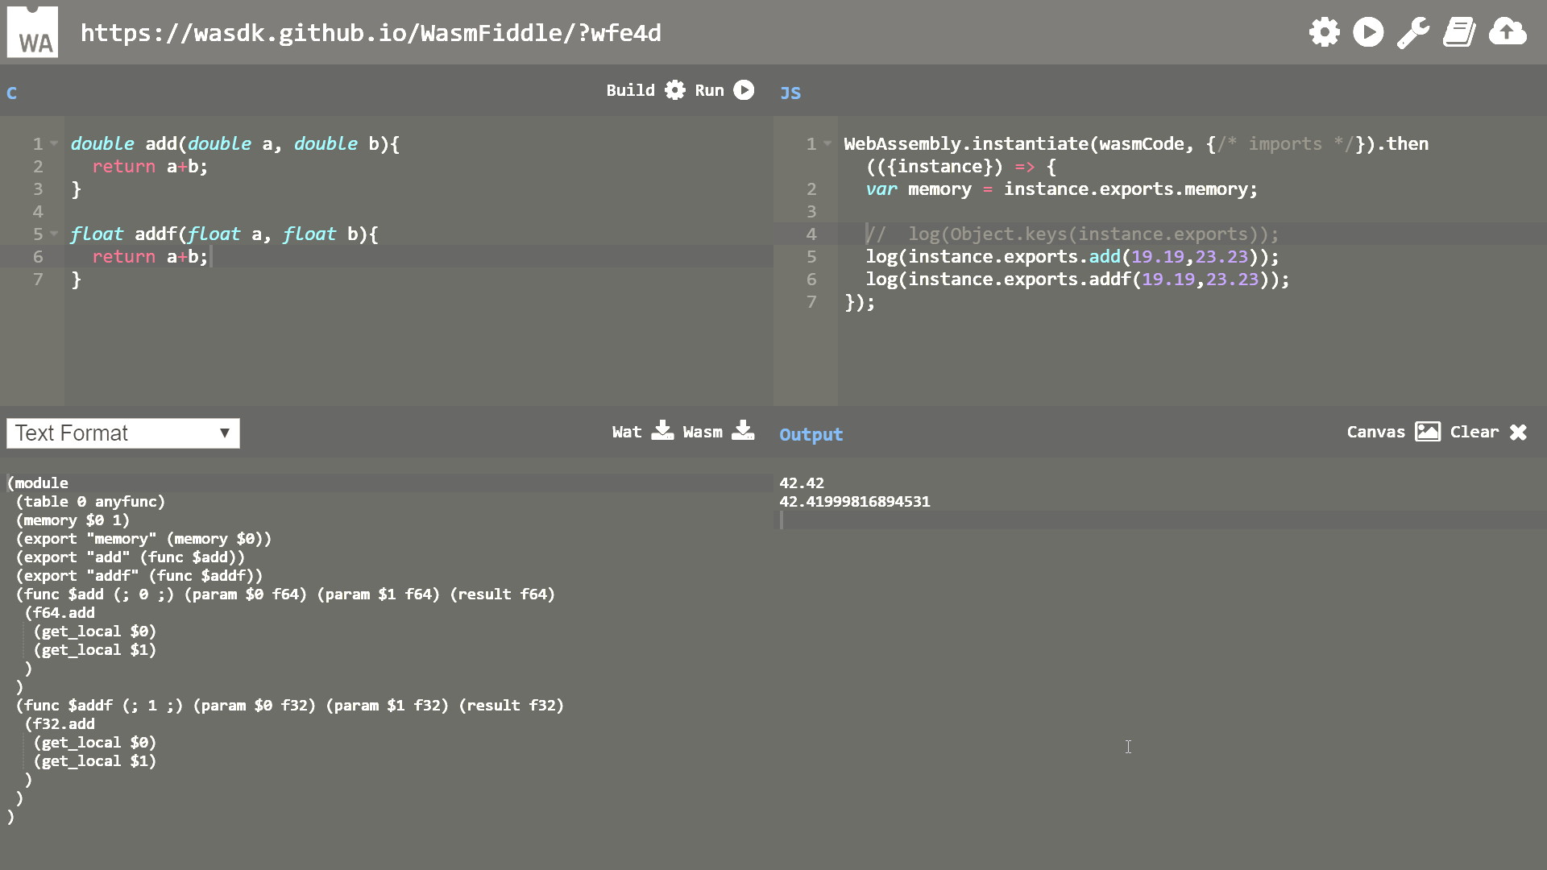

Slide 46
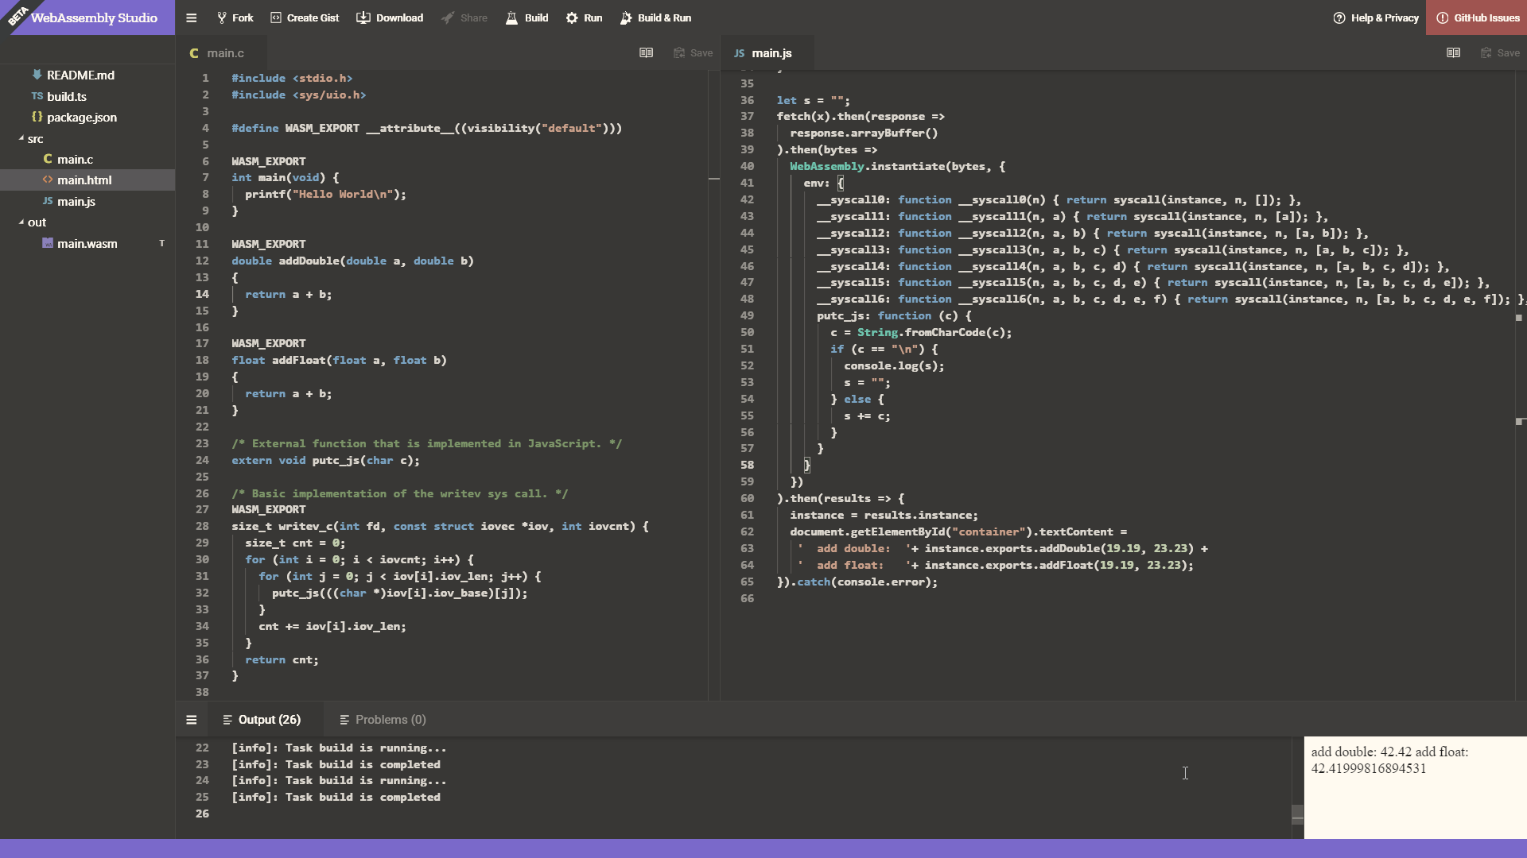
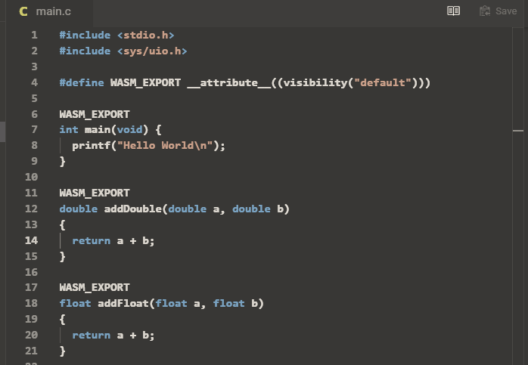
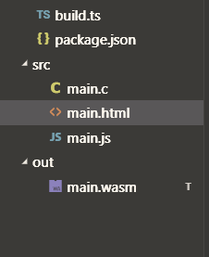
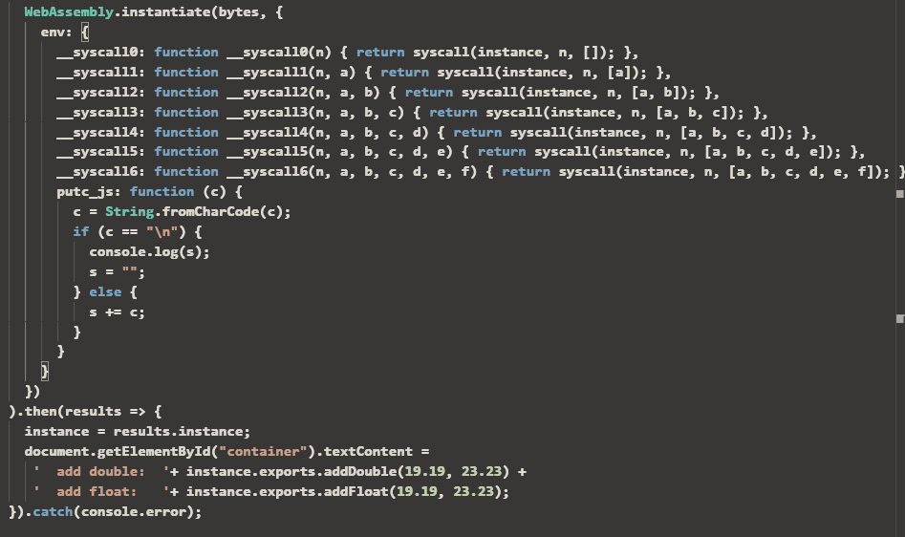
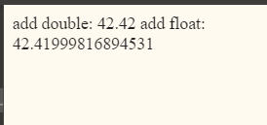

Slide 47
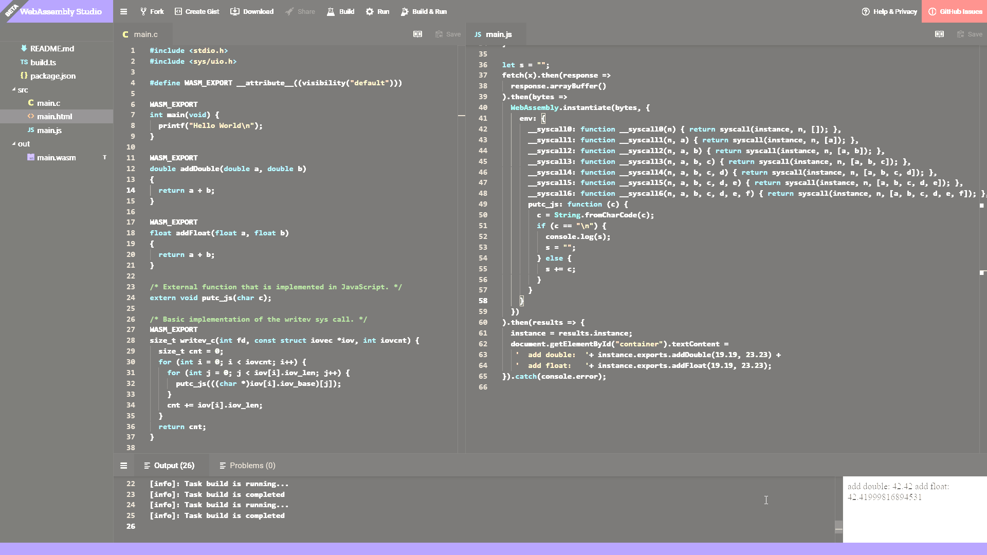
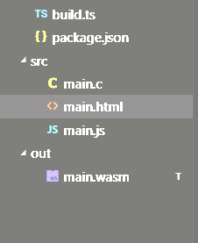
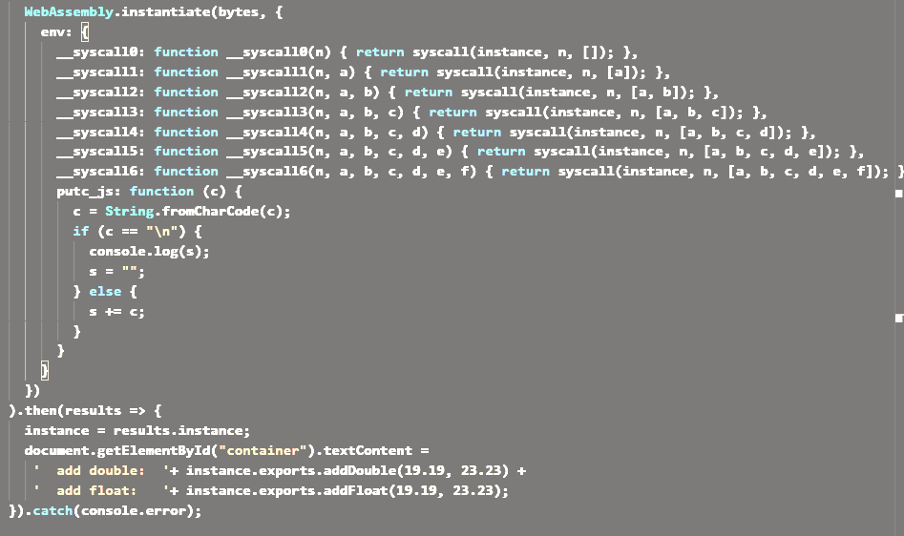

Slide 52
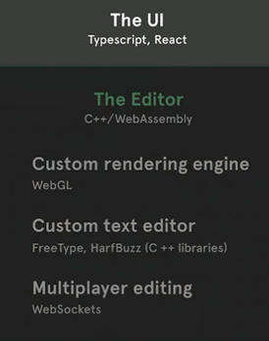
WASM in real world
Figma
https://www.figma.com
https://www.youtube.com/watch?v=Kf1gILChfks
Notes:
Unreal 4 ported in 3 days
Autodesk okolo roku od pierwszego spojrzenia na technologie w pelni dzialajaca aplikacja
Figma
Editor – C++ wasm
Custom rendering engine – WebGL
Text editor – FreeType, HalfBuzz – Existing C++ libraries
Multiplayer editing – webSockets

Slide 53
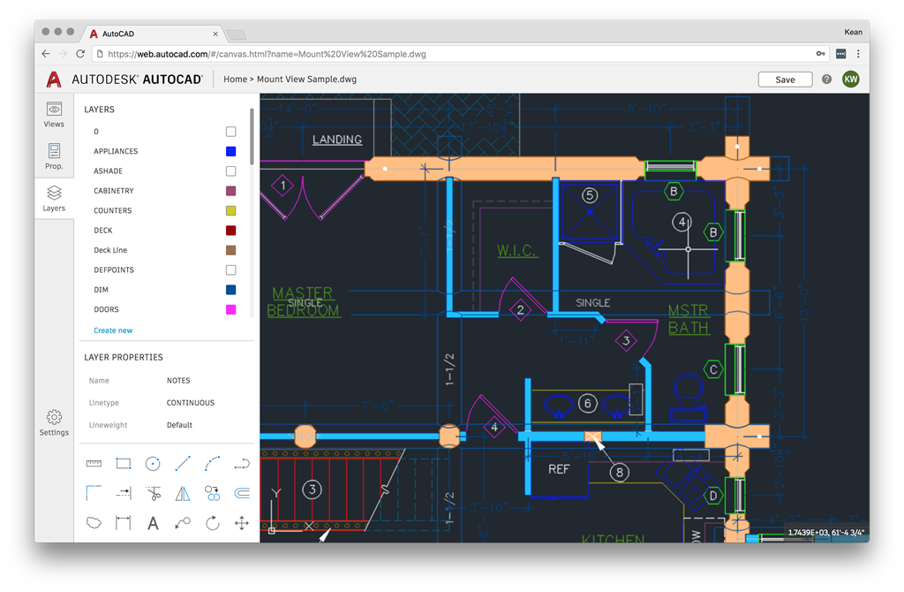
WASM in real world
http://through-the-interface.typepad.com/through_the_interface/2018/03/the-future-of-autocad.html
Notes:
Autodesk okolo roku od pierwszego spojrzenia na technologie w pelni dzialajaca aplikacja
Adobe lightroom

Slide 54
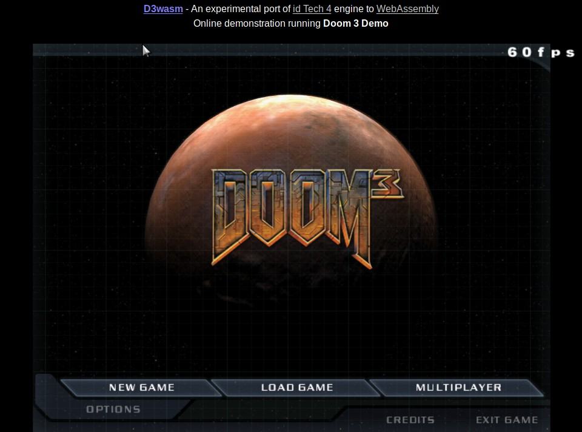
http://www.continuation-labs.com/projects/d3wasm/?fbclid=IwAR2V9OqEDgu3bu-vMNlxcZCUOm0HQAlv6ys-jcZGSMQY56saD8FYrHdVx_s

Slide 55
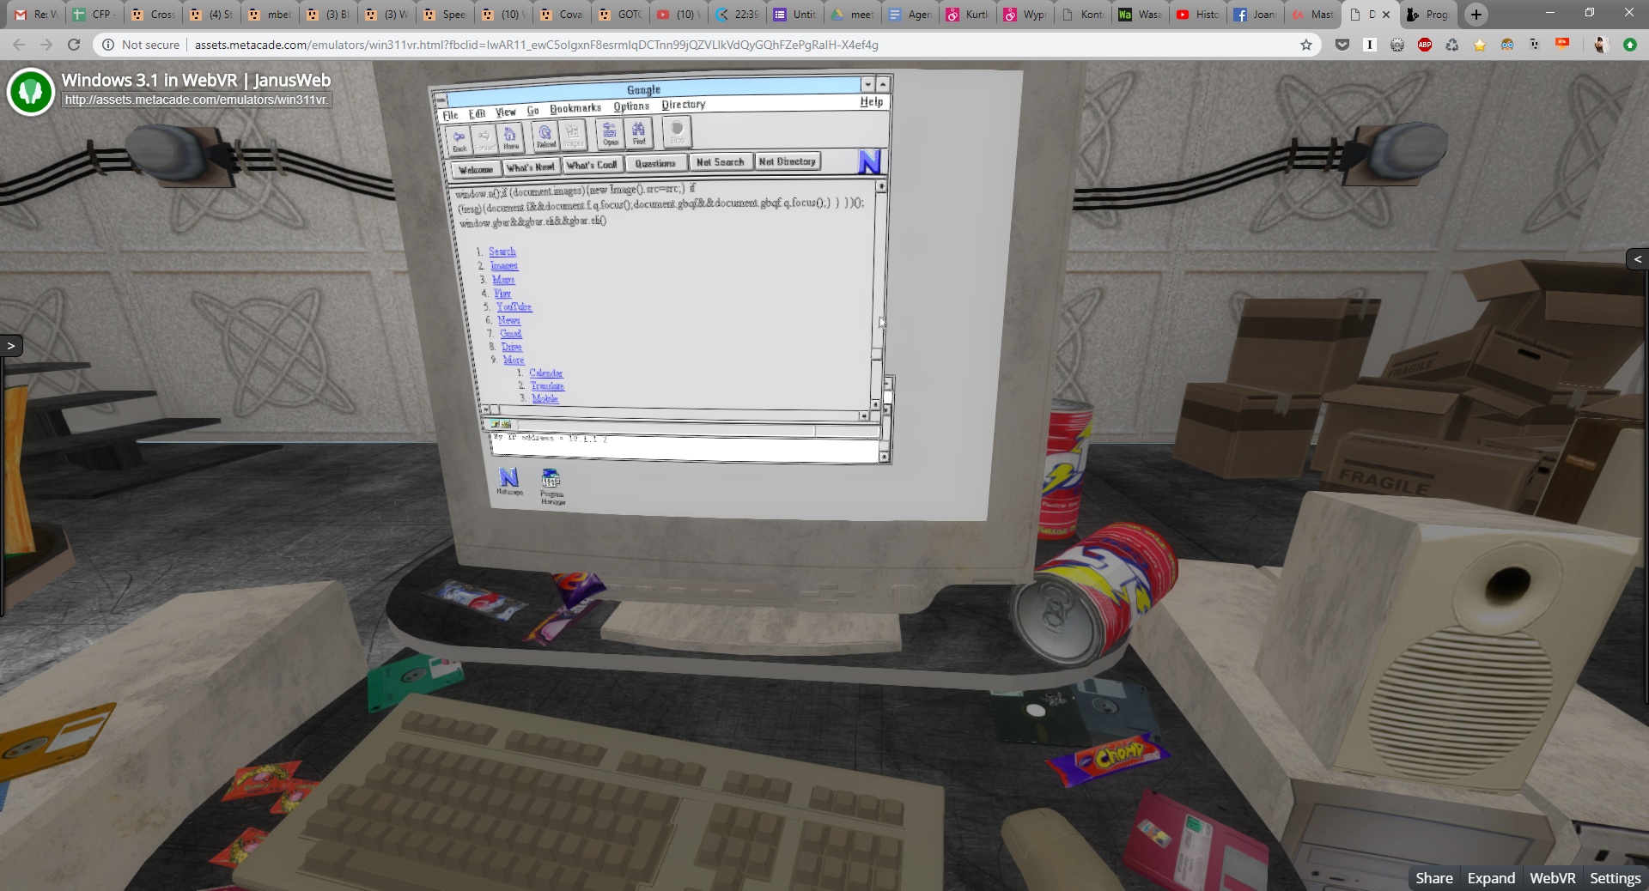
http://assets.metacade.com/emulators/win311vr.html?fbclid=IwAR11_ewC5oIgxnF8esrmlqDCTnn99jQZVLlkVdQyGQhFZePgRaIH-X4ef4g

Slide 56
WASM in real world
Figma
https://www.figma.com/
https://www.youtube.com/watch?v=Kf1gILChfks
https://s3.amazonaws.com/mozilla-games/ZenGarden/EpicZenGarden.html?fbclid=IwAR0_uAensGfTj1Mzp4wXgVoxZjquxRo_uu2YD8yDuleTpPohaXyilDd82X8
https://bellard.org/jslinux/vm.html?url=https://bellard.org/jslinux/win2k.cfg&mem=192&graphic=1&w=1024&h=768
https://aesalazar.github.io/AsteroidsWasm/
http://sqliteefcore-wasm.platform.uno/
https://raytracer-mono-aot.platform.uno/
http://www.continuation-labs.com/projects/d3wasm/?fbclid=IwAR2V9OqEDgu3bu-vMNlxcZCUOm0HQAlv6ys-jcZGSMQY56saD8FYrHdVx_s
http://assets.metacade.com/emulators/win311vr.html?fbclid=IwAR11_ewC5oIgxnF8esrmlqDCTnn99jQZVLlkVdQyGQhFZePgRaIH-X4ef4g
Notes:
Pogrubiony –
Maszyna wirtualna linuxowa z osadzonym Windows2000

Slide 57
What’s the future?

Slide 58
What WebAssembly are next to?
Loadtime improvements
streaming compilation
tiered compilation
implicit HTTP caching
other improvements
Making use of modern Hardware
threading
SIMD
wasm 64bit
https://github.com/WebAssembly/design/blob/master/FutureFeatures.md
Notes:
Heavy weight applications
Streaming compilation – czyli kompilacja w trakcie przesylania pliku
Single instruction, multiple data (SIMD)
SIMD (ang. Single Instruction, Multiple Data) – jeden z podstawowych rodzajów architektur komputerowych według taksonomii Flynna, obejmujący systemy, w których przetwarzanych jest wiele strumieni danych w oparciu o pojedynczy strumień rozkazów. Architektura SIMD jest charakterystyczna dla komputerów wektorowych.
Pierwsze komputery o architekturze SIMD stosowano głównie do obliczeń naukowo-technicznych (np. Geometric-Arithmetic Parallel Processor czy Thinking Machines CM-1 i CM-2). Obecnie jednostki realizujące zadania zgodnie z metodologią SIMD obecne są także w stosowanych w domowych komputerach procesorach opartych na architekturze x86 (i386) oraz x86-64 (amd64). Procesory te oferują listę rozkazów poszerzoną o zestawy rozkazów typu SIMD, takie jak: MMX, 3DNow!, SSE, SSE2, SSE3, SSSE3, SSE4, SSE5, AVX, AltiVec.

Slide 59
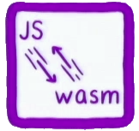
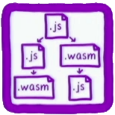
What WebAssembly are next to?
fast calls JS <~> wasm
esy and fast data exchange
ES module integration
toolchain integration like npm or webpack
backward compatibility
Notes:
Mniejsze aplikacje, nie tylko duże
Potrzebujemy tego samego toolsetu i doświadczenia jak z JS,
Potrzebujemy szybkiej komunikacji z js oraz integracji z modulami es aby było jedno drzewo wywołań i optymalizacji
Większość jest dostępne dla RUST ale reszta języków i musiałaby się tym zajac sama

Slide 60
What WebAssembly are next to?
Hight level language features
GC integration
Exception handling
Debugging
Tail cals

Slide 62
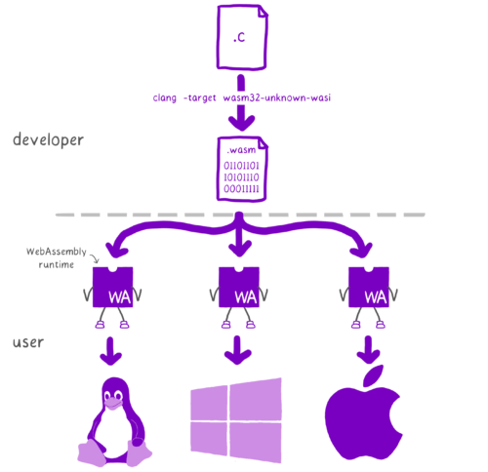
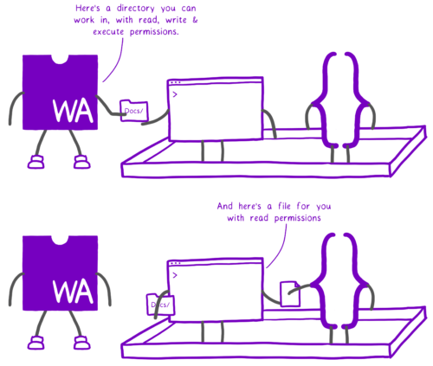
WASI – WebAssembly System Interface
Security
Portability

Slide 63
WebAssembly for serverless

Slide 64
So WebAssembly?
Possibilities
Flexibility Diversity
Cross-platform
Promise of bright tomorrow for todays projects

Slide 65
Questions??
Joanna Lamch
JLamch@gmail.com
https://JLamch.net https://ProgramistkaIKot.pl
THANK YOU

Slide 66
Bibliografia
https://webassembly.org/docs/high-level-goals/
https://www.smashingmagazine.com/2017/05/abridged-cartoon-introduction-webassembly/
https://www.youtube.com/watch?v=HktWin_LPf4&feature=youtu.be
https://www.youtube.com/watch?v=pBYqen3B2gc
https://www.youtube.com/watch?v=BnYq7JapeDA https://www.youtube.com/watch?v=kS29TT4wk44&feature=youtu.be
https://github.com/mbasso/awesome-wasm
https://github.com/migueldeicaza/mono-wasm
https://superkotlin.com/kotlin-and-webassembly/
https://medium.com/@mumarov/how-to-get-started-with-kotlin-native-and-web-assembly-baa2813f0d9
https://github.com/DenisKolodin/yew
https://www.mergeconflict.fm/89
https://dotnetrocks.com/?show=1539
https://dotnetrocks.com/?show=1540
https://dotnetrocks.com/?show=1537
https://www.hanselman.com/blog/NETAndWebAssemblyIsThisTheFutureOfTheFrontend.aspx https://hacks.mozilla.org/2018/04/sneak-peek-at-webassembly-studio/
https://github.com/migueldeicaza/mono-wasm?WT.mc_id=-blog-scottha
https://blog.scottlogic.com/ceberhardt/
https://blog.logrocket.com/working-with-the-blazor-javascript-interop-3c2a8d0eb56c https://s3.amazonaws.com/mozilla-games/ZenGarden/EpicZenGarden.html https://blog.logrocket.com/working-with-the-blazor-javascript-interop-3c2a8d0eb56c

